Slide 2
Introducing XP practices in Team Vision & Its Challenges
Sunil Gupta

Slide 3
Background
Part of Cisco Service Provider Business, working on Set Top Box devices.
We develop solutions for enriching the viewing experience E2E
Software Stack consists of legacy modules and new features keep getting added on top of it
STB Software Stack
Application Layer (Java)
User Experience & Interface
Middleware (C)
Core Functionality
Device Driver

Slide 4
Agile & XP
Who all are working in Agile teams ??
Who all are working in teams which follow XP practices ??
Who all are following both ??
Is there any co-relation between them ??

Slide 5
Agile Transformation
We started our agile transformation journey in first half of 2014
Adopted Scrum framework
Moved from Component based Team to Vertical Team. New roles got introduced
Focus on automation to support continuous testing

Slide 6
State Transition
Problems
Observed
Trigger
S1
Introducing XP Practices
S2
Action
Current State of
Scrum Team
Vision for
Scrum Team

Slide 7
Team State
Team has learned the agile practices; Standup, SPM, Retrospection..
Were moving towards becoming self organizing teams
Quality of software has improved (defect were caught in sprint & fixed)
Automation tool was introduced
CI was in place and automated test cases were added as part of CI
Teams were expanding, new members joining team

Slide 8
Waterfall Project Management
Component Based Team
Existing Development & Automation Practices
SCRUM Vertical Team
Standup Sprint Planning Meeting Retrospection Backlog Grooming
Existing Development & Automation Practices

Slide 9
Trigger
Unreliable automated test cases
Team members wondering about effectiveness of automation
Quality of test code
Continuous Integration stuck at Continuous Compilation
Defects still coming up during testing (inside sprint boundary)
Ramp up of new developer slower
Started looking in to some of XP practices, better ways of automation

Slide 10
Introduced to New Terms
Test First Approach
To identify all test cases through brainstorming inside team
Using BDD as framework
Pair Programming
Knowledge sharing
Real time code review
Ramp up
Test Pyramid
What to Automate and at What Level
Effective Use of CI
Building reliable continuous integration pipeline
“Building Quality In” instead of “Checking Quality”

Slide 11
Communication of Vision
Communication of Vision is one of the most important step
Two type of stakeholders : Scrum Teams & Leadership
Leadership ( Project Manager, Engineering Leadership, PO etc)
Problem statement has to be explained clearly with expected output
Success Story from Industry
Credibility (from previous transformation & result)
Scrum Team
It’s mainly a cultural change, old habits (of domain expert) need to be changed
One of the key agile principle which is going to help the most is “Experiment for A Sprint”
With team already understanding agile practices, it helps

Slide 12
Right Team, Right Place, Right Pace
Team
2 out of 6 scrum teams
Open Mind & Credible Developers
Place
System had log of legacy code
Introduce it in new Feature Development
Moderate to High Complexity Feature
Pace
Pace it out, one practice per sprint
Retrospect and Tweak
You need to put your heart & soul

Slide 13
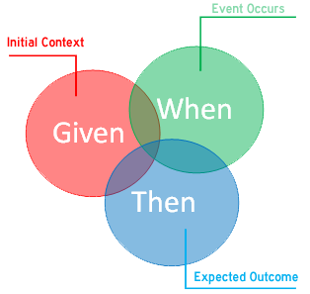
Test First Approach
Identifying all test scenarios before starting development
Scrum Teams normally has members who were earlier part of QC teams
Made them messenger for this practice
Introduction of BDD was like adding new dimension to their learning
Brings focus on Quality before any code is written
Helped in making user stories smaller and frequent delivery of code

Slide 14
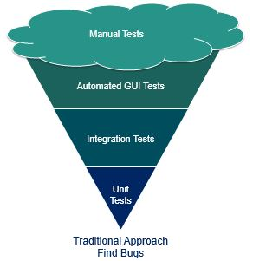
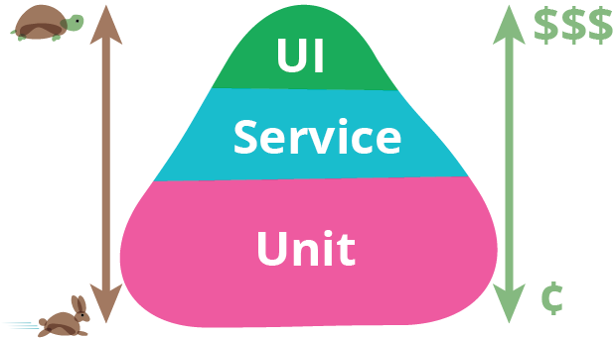
Test Pyramid
Concept by Mike Cohn
A critical step to streamline automation but also challenging one
Lot of Legacy Code
Middleware did not have any unit testing framework, only service level testing framework
Application layer used Junit , but quality of test code was a concern
UI Level Automation

Slide 15
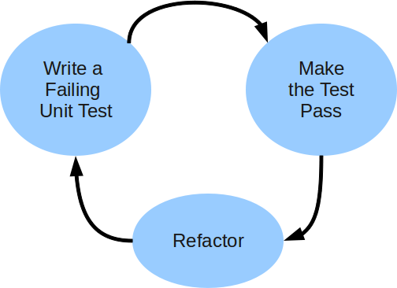
Test Pyramid
Identify BDD Scenarios
Map to Test Pyramid
Write Test Code & Feature code in Parallel
Usage of NovaProva (UT framework for C) for Middleware
Effective Usage of Service Level testing framework for Middleware
Introduced Test Driven Development for writing JUnit
Brought out need of refactoring

Slide 16
SCRUM Vertical Team
Standup Sprint Planning Meeting Retrospection Backlog Grooming
SCRUM Vertical Team
Standup Sprint Planning Meeting Retrospection Backlog Grooming
Existing Development & Automation Practices
Quality NET Test Case BDD Test Pyramid Test Code TDD
Existing Development Practices

Slide 17

Pair Programming
Explained Pair Programming, some Demo Session with coaches, Training Session
Next sprint , team started feeling lost
Challenges
Team consists of Java Dev, C Dev, QC, Experts, New team member
When to pair
Why are we pairing
Its not giving any advantage

Slide 18
Pair Programming
Task | Pair | Goal | Driver- Navigator Switch
Code Development | Developers with similar expertise | Quality of Code | Yes
Scenario Identification | Any two team members | Quality of scenarios | Yes
Script Development | Any two team members | Script Quality | Yes
Code Development | Developer of two different expertise | Quality of code: by identifying the gap in logical decision making or flows | No
Test Code development (Ex - Integration test, Unit test, scripts) | Developer & QC expert | Quality of code by identifying the gap in scenario handling | No
Tweaked our approach to bring clarity
At end of every standup, team identifies the task , with pair and its time
Encouraged pairing with code reviewer itself

Slide 19
Refactoring
Introduction of UT & TDD, brought focus on Clearly Defined function
TDD & UT was difficult for poorly defined functions
Key was team feeling the need for refactoring
Creating safety net first using UT and then refactoring
Challenges
Lot of Legacy Code
Cost- Benefit Analysis

Slide 20
SCRUM Vertical Team
Standup Sprint Planning Meeting Retrospection Backlog Grooming
SCRUM Vertical Team
Standup Sprint Planning Meeting Retrospection Backlog Grooming
Quality NET Test Case BDD Test Pyramid Test Code TDD
Quality NET Test Case BDD Test Pyramid Test Code TDD
Existing Development Practices
Pair Programming Refactoring
Legacy Architecture, Code

Slide 21
Next Steps
Using two teams and key member as catalyst for introducing practices to remaining 3 teams in project
Creation of Automated Test Suites, for streaming lining the Continuous Integration
Feature based Test Suite
Nightly Test Suite

Slide 22
Sunil Gupta, Engineering Manager Cisco Video Technology sunilg1411@gmail.com, https://in.linkedin.com/in/sunil-gupta-89092433
Thank You

